Slide 1

Diabetes disease prediction PROJECT - Exposys data labs

Slide 2
Presented By:
NAME | Email ID
Kaviti Saikiran | Kaviti_ug@ee.nits.ac.in
Mekala Mukhesh Chandra | Mekal_ug@ee.nits.ac.in
Gurivelli Satish | Gurivelli_ug@ee.nits.ac.in
Under Guidance of
Vishnu Vardhan Y
(Founder at Exposys Data Labs)

Slide 3
INTRODUCTION TO DIABETES:
Diabetes is a disease that occurs when your blood glucose, also called blood sugar, is too high. Blood glucose is your main source of energy and comes from the food you eat. Insulin, a hormone made by the pancreas, helps glucose from food get into your cells to be used for energy. Sometimes your body doesn’t make enough—or any—insulin or doesn’t use insulin well. Glucose then stays in your blood and doesn’t reach your cells.
Over time, having too much glucose in your blood can cause health problems. Although diabetes has no cure, you can take steps to manage your diabetes and stay healthy.
Sometimes people call diabetes “a touch of sugar” or “borderline diabetes.” These terms suggest that someone doesn’t really have diabetes or has a less serious case, but every case of diabetes is serious.
DATA OVERVIEW:
Data Set Link: https://www.kaggle.com/uciml/pima-indians-diabetes-database
Pregnancies: Number of times pregnant
Glucose: Plasma glucose concentration a 2 hours in an oral glucose tolerance test
Blood Pressure: Diastolic blood pressure (mm Hg)
Skin Thickness: Triceps skin fold thickness (mm)
Insulin: 2-Hour serum insulin (mu U/ml)
BMI: Body mass index (weight in kg / (height in m)^2)
Diabetes Pedigree Function: Diabetes pedigree function
Age: Age (years)
Outcome: Class variable (0 or 1) 268 of 768 are 1, the others are 0

Slide 4
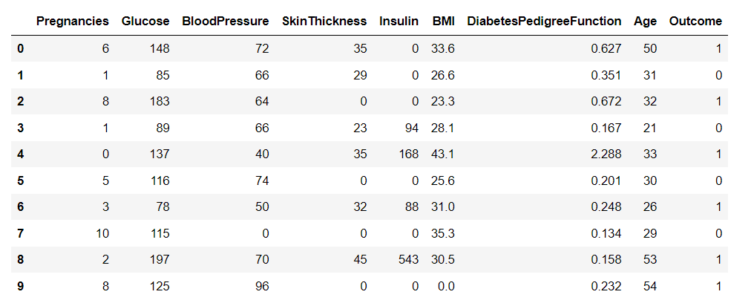
DATA frame OVERVIEW:

Slide 5
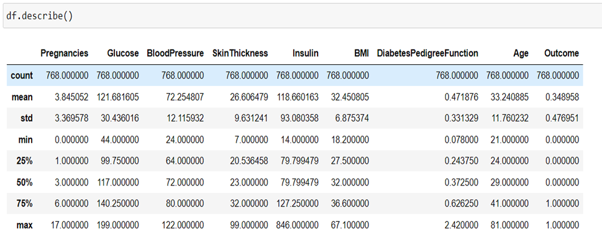
ANALYSIS OF DATA SET:
Statistical Summary of the dataset in a single data frame.

Slide 6
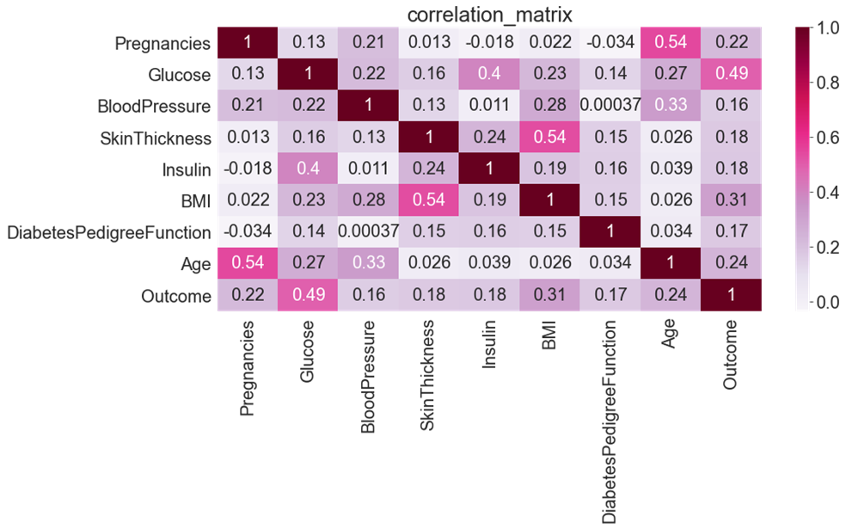
Correlation Analysis:
Correlation of two columns indicates the relationship between the two columns in other words it indicates how strongly two columns are related to each other and are affected by each other. From the heat map we can observe that there are no strong relations between any of the columns (>0.5) The greatest correlation is between the pregnancy and the age column followed by the correlation between glucose and output columns respectively followed by glucose and insulin columns.

Slide 7
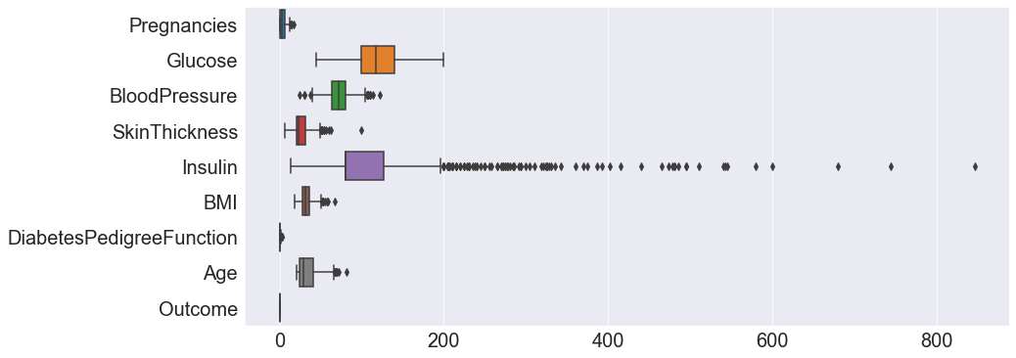
Box Plot of the Data Set for checking the Outliers:

Slide 8
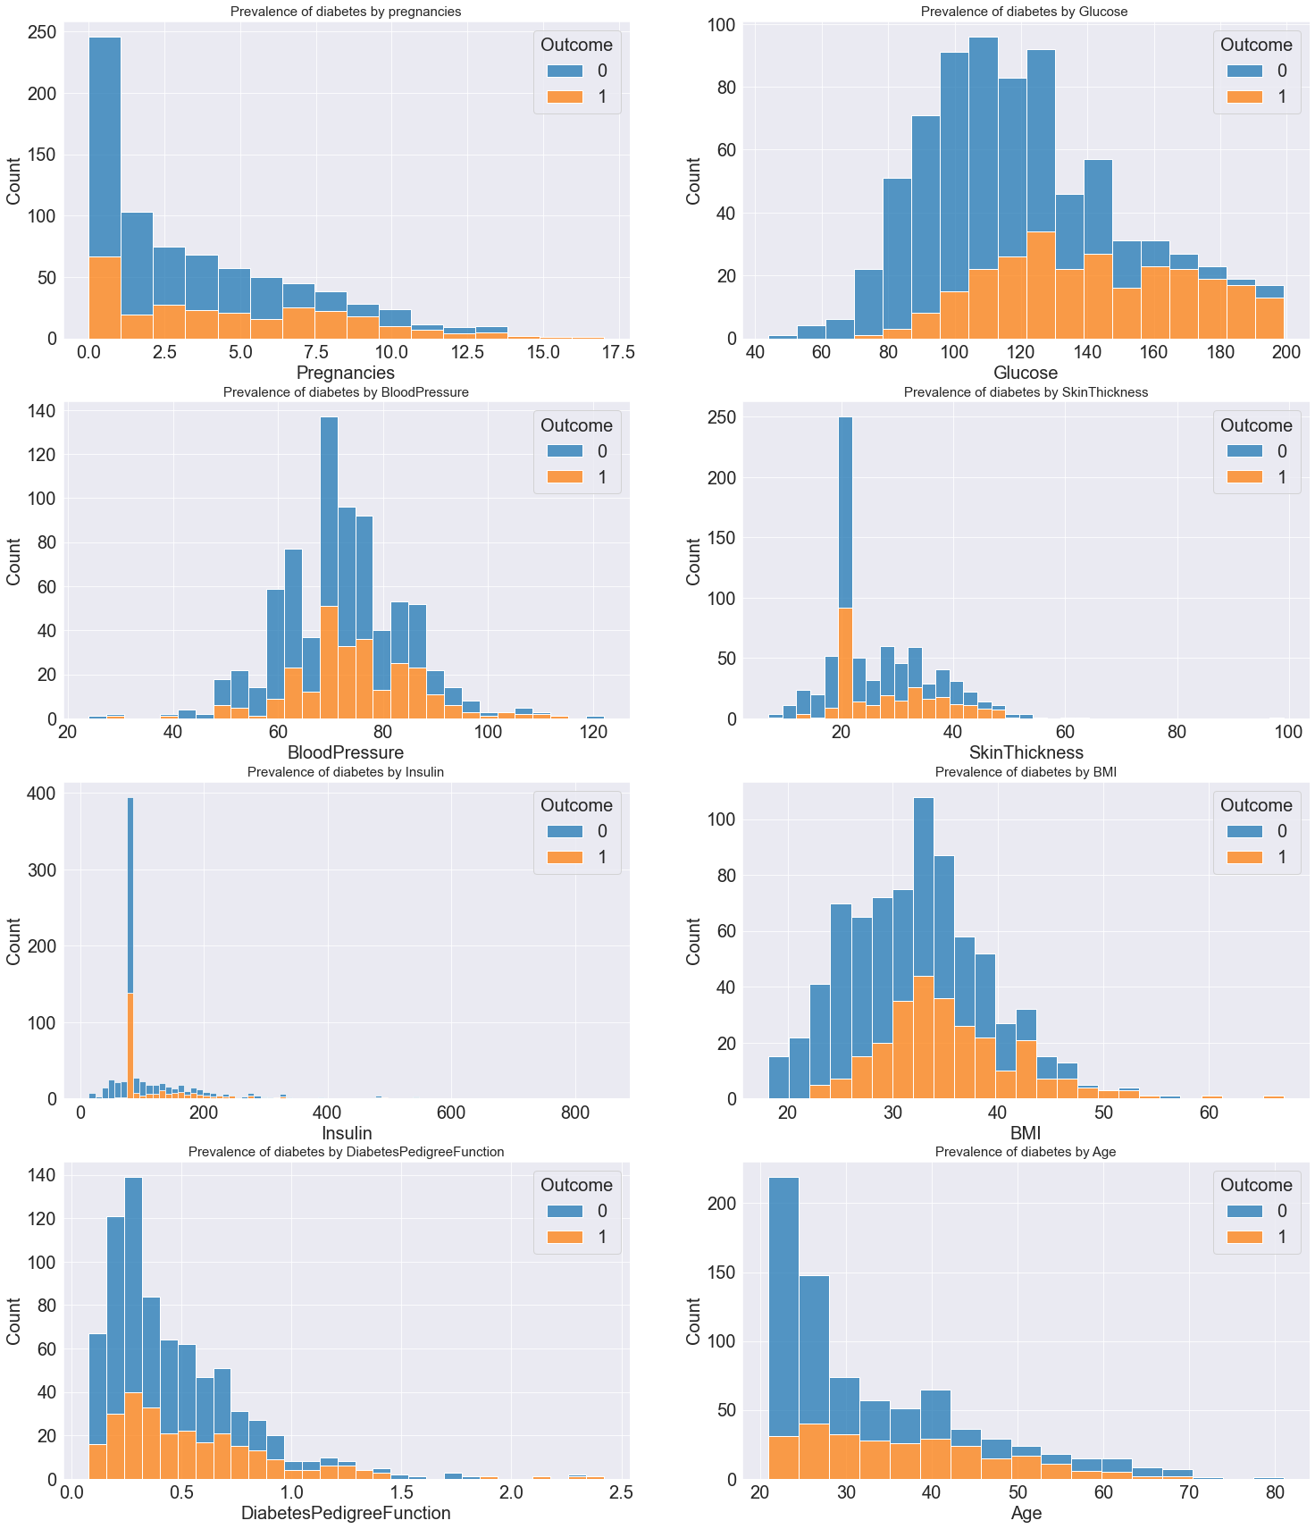

Slide 10
Insights:
In general, 20 to 45 aged people have more chance of Diabetes.
Blood pressure 60 to 80
skin thickness with 20 have more chances
insulin with around 80 have more chances
BMI > 30
Diabetiespedegreefunction with 0.1 to 0.7
zero pregnensies have more chances
glucose > 110

Slide 11

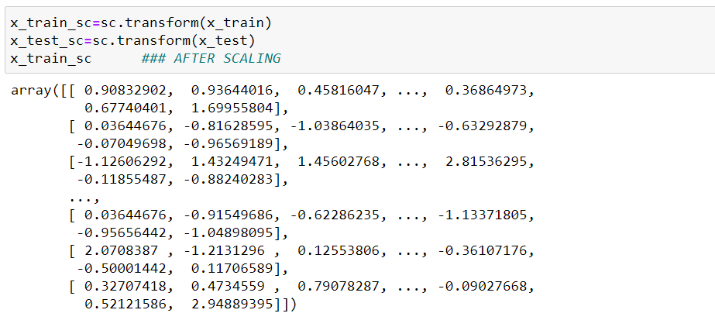
Scaling of Data:

Slide 12

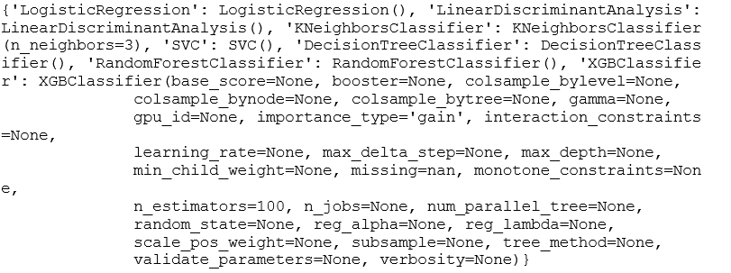
Models Implementation
Created the dictionary of models we have used the zip function.
Models are as follows:
Implementation of each model is done.
LOGISTIC REGRESSION
K NEAREST NEIGHBORS
RANDOM FOREST CLASSIFIER
DECISION TREE CLASSIFIER
SUPPORT VECTOR CLASSIFIER
LinearDiscrimaninantAnalysis.
XG BOOST.

Slide 13
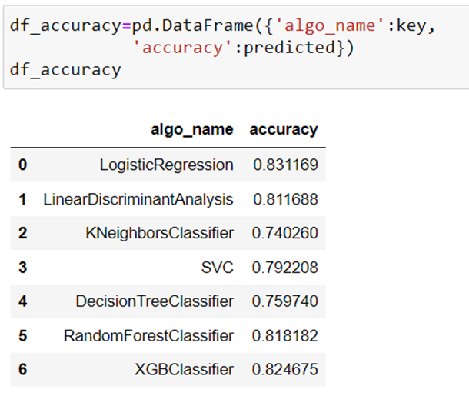
Accuracies of different models:
From the data frame of accuracies we can observe that the Logistic Regression model is showing the high accuracy of 83.116% thus we can say it is the best fit model to prediction of the diabetes using the PIMA Data Set

Slide 14
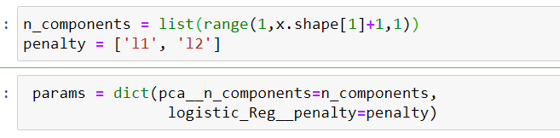
HYPER PARAMETER TUNING:
A Machine Learning model is defined as a mathematical model with a number of parameters that need to be learned from the data. By training a model with existing data, we are able to fit the model parameters. However, there is another kind of parameters, known as Hyperparameters, that cannot be directly learned from the regular training process. They are usually fixed before the actual training process begins. These parameters express important properties of the model such as its complexity or how fast it should learn.
Parameters we considered are as follows:
Penalized logistic regression imposes a penalty to the logistic model for having too many variables. This results in shrinking the coefficients of the less contributive variables toward zero. This is also known as regularization.

Slide 15
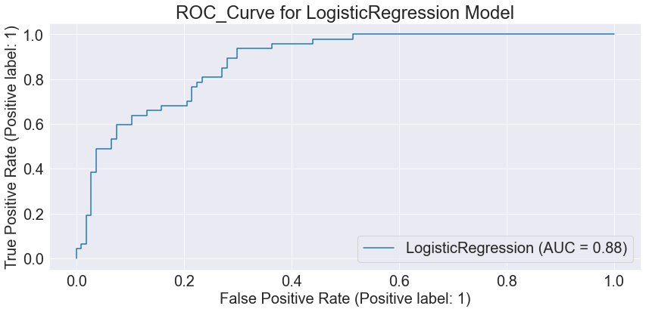
Model Accuracy Testing: The ROC curve does this by plotting sensitivity, the probability of predicting a real positive will be a positive, against 1-specificity, the probability of predicting a real negative will be a positive. we have plotted the ROC curve using estimating model we considered to be high accurate.
The more the bend is towards the top left corner we can the model is more the accurate.

Slide 16
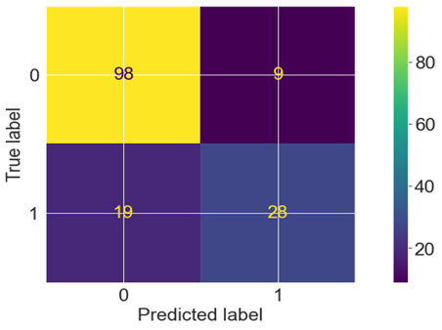
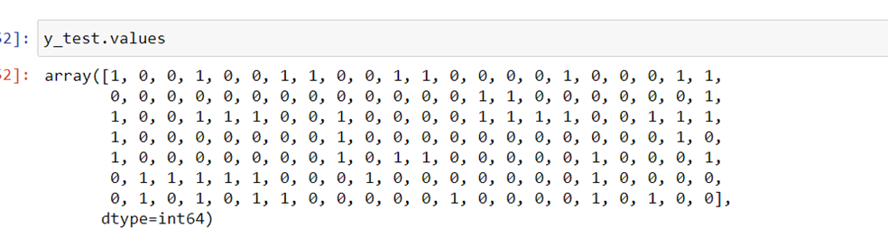
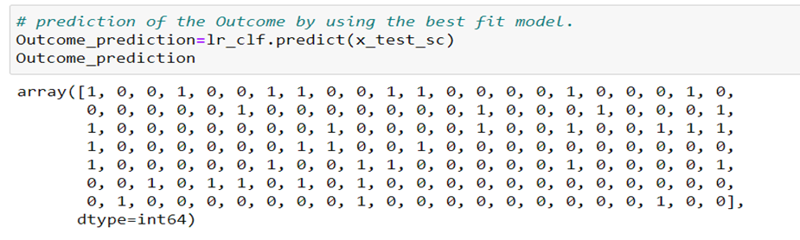
Confusion Matrix:
True and Predicted values are as follows:
98 -True negative values.
28-True positive values after the prediction is done.

Slide 17
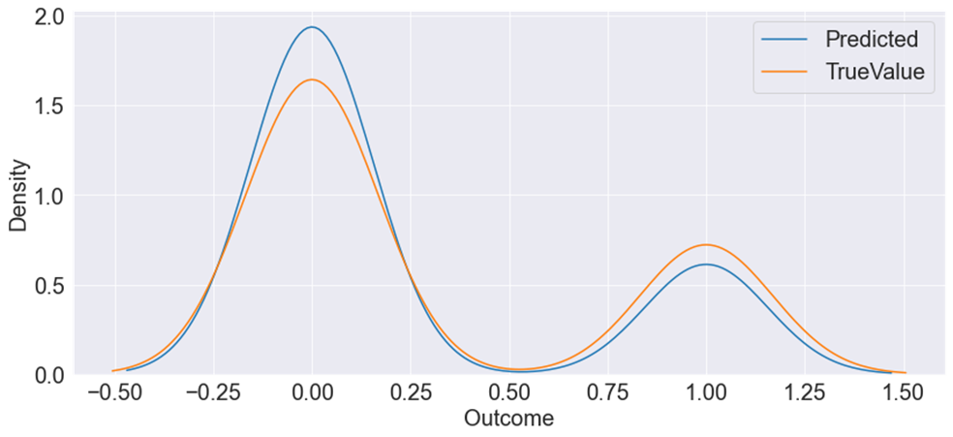
CONCLUSION: After performing the hyper parameter tuning on several models, and testing for the accuracy of each model, we conclude that the LOGISTIC REGRESSION algorithm showed the best performance with an accuracy of 83.11%.

